Slide 1
STAT596: Regression & Time series analysis
Final Project Presentation
House Price Prediction
Presented by,
Usha Kiran Bellam (ub39)
Yaniv Bronshtein (yb262)
Harshini Bonam (sdb202)
Venkata Raju Datla (vkd20)

Slide 2
Problem Definition
House price depends on various factors.
Market prices → Major contributor
We want to build a model to help people take informed decisions while buying a house so that no one will incur loss while buying or selling the home in accordance with the market rate.

Slide 3
Key Objective:
Using different Regression algorithms to attribute house prices to different components of the house.
Create a model that can predict price of new unseen houses in the area.

Slide 4
Dataset
House sales in King County, WA, US
From Kaggle (link in references)
As CSV file
With 21613 data-points, and
20 features for each house selling price

Slide 5
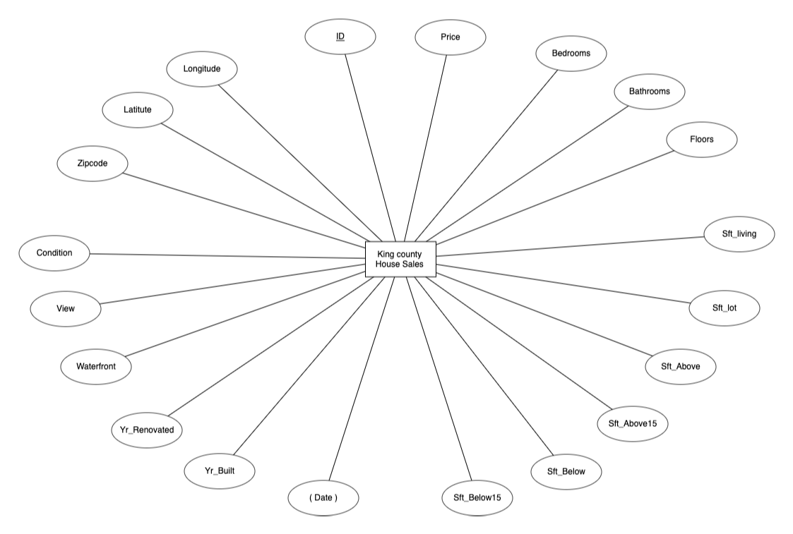
Entity relationship diagram

Slide 6
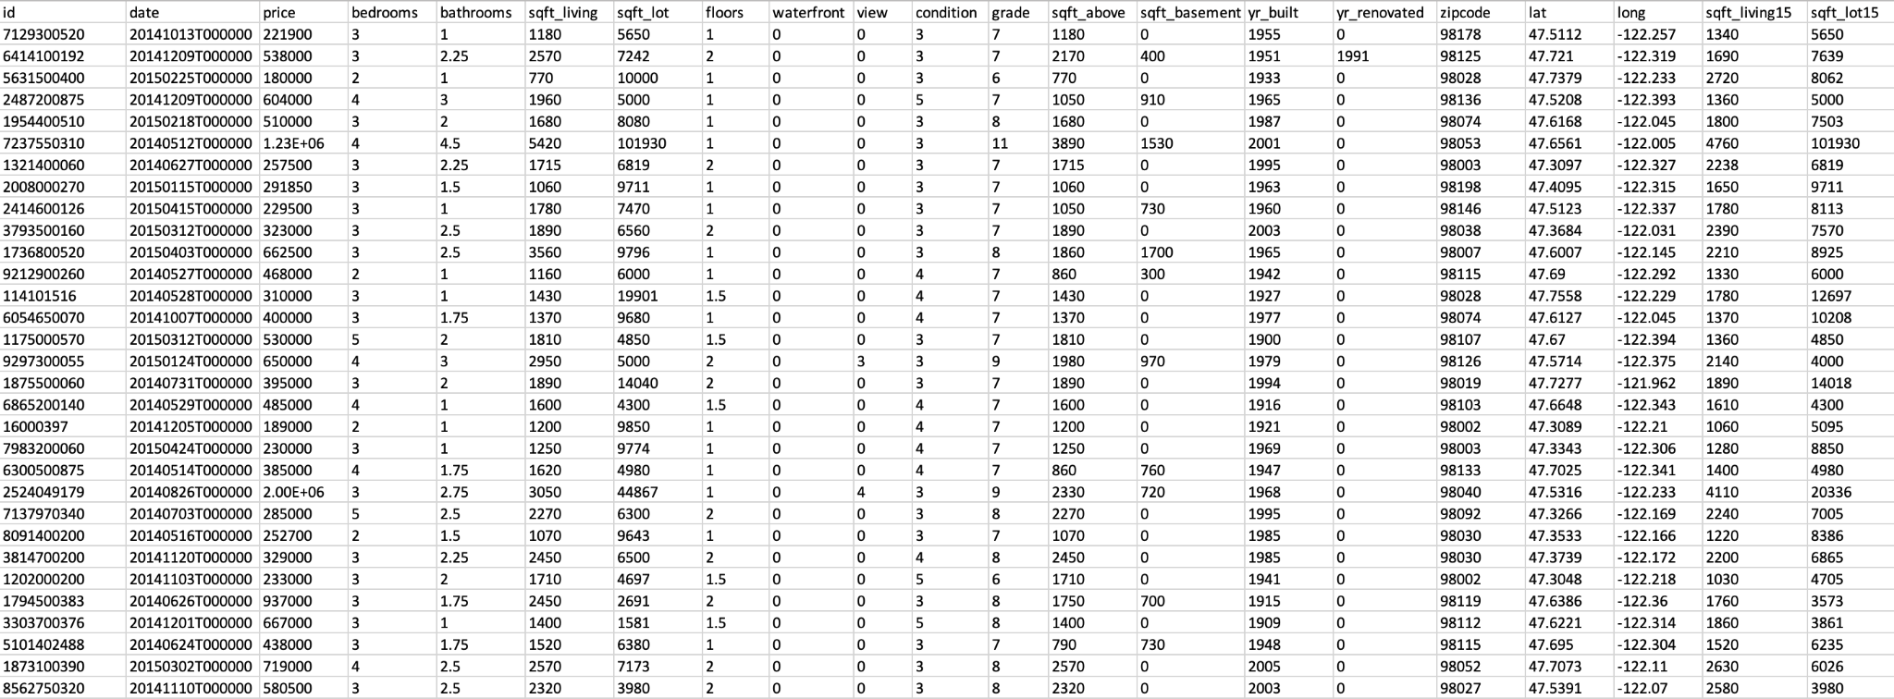
Data Snippet

Slide 7
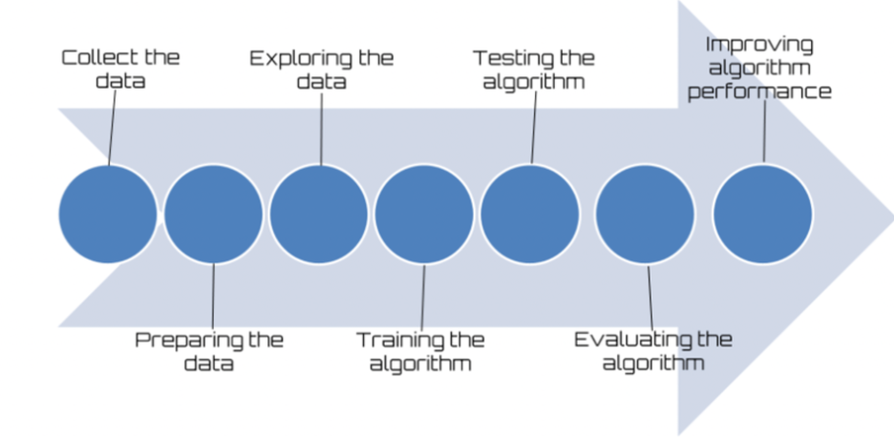
Methodology

Slide 8
Data Cleaning and Preprocessing
Converting day-hours to date using pd.t-datetime()
Checking for null/NA values - None found
Checking for duplicate entries.
Exclude 'id','date', 'zipcode', 'yr_renovated' since they are not useful for this ML problem
Performed a 70-30 Train-Test split
Set random seed 110 for reproducibility

Slide 9
Key results from the EDA on the data
One floor houses are the most common type of houses sold
Houses with the waterfront have higher price as expected
House condition is rated from 1 to 5 and the most common rating is 3
House grade is rated from 1 to 13 and the most common rating is 7

Slide 10
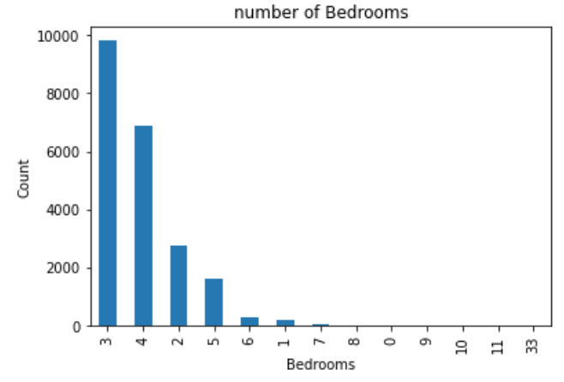
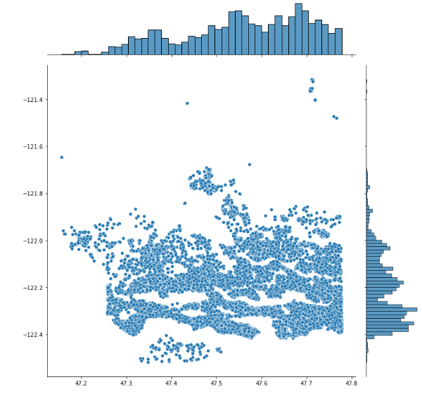
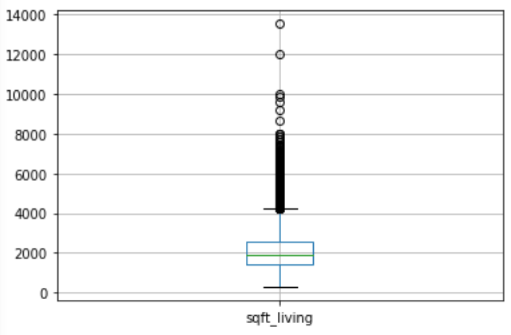
Univariate Analysis
Barplot of bedroom number shows that 3 bedroom houses are most prevalent
Houses with latitude [47.5,47.8] and longitude [-122.2,-122.4] were most desired
Boxplot for each feature used to remove outliers from the data

Slide 11
Bivariate Analysis
Checked the correlation of independent variables with price and below are the variables that are most correlated.
Additionally, several of the features below were correlated with other features, demonstrating multicollinearity.
Feature | sqft_living | bathrooms | grade | sqft_above | sqft_living15
Pearson correlation with price | 0.702035 | 0.525138 | 0.667434 | 0.605567 | 0.585379

Slide 12
Modeling
Dataset split: 70% train - 30% test
Baseline:
Multiple Linear Regression
Shrinkage Methods:
Ridge and Lasso Regression
Basic Tree Methods:
Decision Tree Regression with and without tuning using Grid-Search
Ensemble Learning Methods:
Random Forest with and without tuning using Grid-Search
Gradient Boosting

Slide 13
Multiple Linear Regression
Used to understand the significance of features in predicting the value of housing price
Metric | Multiple R-squared (Train) | Multiple R-squared(Test)
Value | 0.694 | 0.697

Slide 14
Lasso and Ridge Regression
Tried regularization methods to shrink coefficients
Lasso fit with alpha=0.1 and Ridge fit with alpha=0.3 through trial and error
None of the coefficients are compressed to zero implying that there are multiple independent variables contributing to the price
 | Multiple R-squared (Train) | Multiple R-squared(Test)
Lasso | 0.693681 | 0.697004
Ridge | 0.693681 | 0.697042

Slide 15
Decision Tree Regression
A decision tree is a model used to predict a target by learning decision rules from data.
In Regression case, the tree splits the data in such a way that the R squared is optimized
R squared improved from 70% obtained for regression analysis to 75%
We have used the CV to optimize the hyperparameter depth, which came out to 10 for this data set
Generally, Decision tree is not solely used. Models like Random forest and boosting models are used which makes use of the Decision trees and are shown to display superior results.

Slide 16
Random Forest Regression
An ensemble method is a technique that combines the predictions from multiple ML algorithms
the two main ensemble methods which we’ve used in the project are Random forest and Gradient boosting
Random forest is a bagging technique which randomly selects a subset of the total features and data when training different decision trees and aggregates the results.
This helps in reducing the variance caused by the decision tree
We noticed a significant jump in the R-squared to 88% from 75% obtained from the earlier models.

Slide 17
Random Forest Regression - Hyperparameter tuning
In order to refine the power of the Random forest regression model, choosing the best hyperparameters to be set as
n_estimators: 220 and
Max_depth: 20
Given,
Cross validation generator as 5
Method of evaluation as R²
No parallel computing jobs
Output
RMSE | Multiple R-squared
354.14 | 0.88

Slide 18
Gradient Boosting Regression
Ensemble Method used to minimize model bias by using a group of decision trees
We used 400 trees, a max depth of 5, min sample split of 2, learning rate of 0.1 and MSE loss function
RMSE | Multiple R-squared
338.575 | 0.897191

Slide 19
Comparison
Method | Test - R²
MLR | 70%
Ridge Regression | 70%
Lasso Regression | 70%
Decision Tree Regression | 72%
Decision Tree Regression with Hyperparameter tuning (max_depth: 10) | 75%
Random Forest Regression | 88%
Random Forest Regression with Hyperparameter tuning (max_depth: 20, n_estimators: 220) | 88%
Gradient Boost | 90%

Slide 20
Conclusion
To predict the prices of houses we first analyzed different independent variables by seeing the correlation of these variables with the target variable price.
We also looked at the multicollinearity of this independent variables.
We then applied multivariate linear regression and achieved a test accuracy of 70%.
We then applied a large group of models and the best accuracy obtained from those models is from gradient boosting regressor which is 90%.
It is once again observed that ensemble techniques help us in achieving high accuracy either it is regression or classification as it involves a large group models and best of these models is taken.

Slide 21
References
Dataset https://www.kaggle.com/harlfoxem/housesalesprediction
MLR python library https://scikit-learn.org/stable/modules/generated/sklearn.linear_model.LinearRegression.html
Lasso python library https://scikit-learn.org/stable/modules/generated/sklearn.linear_model.Lasso.html
Ridge python library https://scikit-learn.org/stable/modules/generated/sklearn.linear_model.Ridge.html
Decision Tree regression python library https://scikit-learn.org/stable/auto_examples/tree/plot_tree_regression.html
Random Forest regression python library https://scikit-learn.org/stable/modules/generated/sklearn.ensemble.RandomForestRegressor.html
Gradient Boosting regression python library https://scikit-learn.org/stable/modules/generated/sklearn.ensemble.GradientBoostingRegressor.html

Slide 22
Thank you!

